Slide 1
Taking on the challenge of food marketing to children in the WHO European region
Joao Breda, Head of WHO NCD Office, Moscow
Jo Jewell, Technical Officer, WHO regional Office for Europe
Enrique Loyola, Coordinator Surveillance, NCD Office
WHO Regional Office for Europe
Notes:
Commissioner Andriukaitis, honourable ministers, distinguished guests, ladies and gentleman, it is my very great pleasure to be with you today and to be invited to speak on a matter of such importance to Europe.

Slide 2
Presentation outline
NCD and risk factors situation and policy context
Marketing promotion, pathways and effects of increased consumption
WHO support to countries

Slide 3
Global Monitoring Framework Scoreboard for Europe L
?
?
?
?
?
?
?
?
?
Notes:
That is the good news. The bad news comes from other data.
[At this point, hold up a printed copy of the publication]
I am today launching this progress monitor, a publication drilling deeper into the country capacity survey, the progress indicators, and other data about the European response to NCDs.

Slide 4
Global Monitoring Framework Scoreboard for Europe Major scope for accelerating achievement
1
2
3
4
5
6
7
8
9
Notes:
As you can see, Europe is on track to achieving the global voluntary targets for premature mortality and for the reduction of hypertension.
But tobacco use and alcohol consumption are declining too slowly, and overweight is rising too rapidly, to achieve the targets in those areas.
Other targets, such as salt reduction, physical activity, and access to essential medicines and technologies, are endangered and not enough is being done about them.

Slide 5
Some improvements in measures to improve diet and physical activity
+13%
+26%
+59%
+41%
Notes:
Add here the line plot for Indicator 8 on awareness for diet and PA
~ Gauden
Done.

Slide 6
…but overweight and obesity are growing at fast pace
+23.1%
+30.2%
+16.2%
+39.5%
+13.8%
+11.2%

Slide 7
Four time-bound commitments
in the 2014 UN Outcome Document on NCDs
Set national NCD targets for 2025 or 2030 and monitor results
Develop a national multisectoral action plan
Implement the "best buy" interventions to reduce NCD risk factors
Implement the "best buy" interventions to strengthen health systems to address NCDs

Slide 8
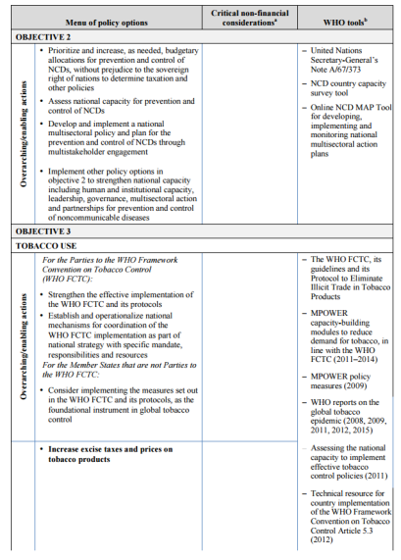
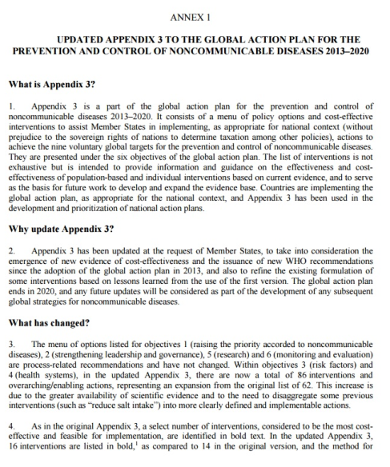
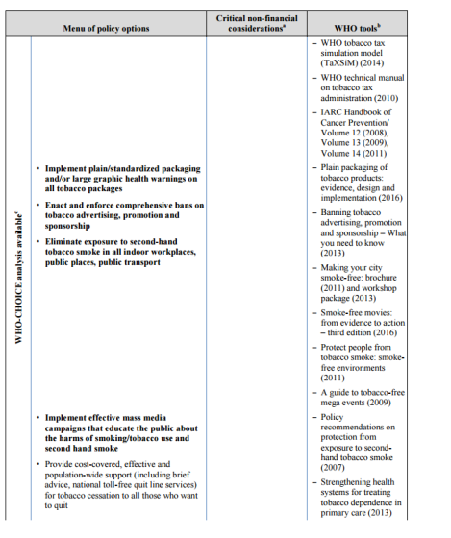
May 2017: Updated set of good and best buys
Endorsed by the World Health Assembly
16 best buys
86 good buys
WHA decision Technical documents

Slide 9
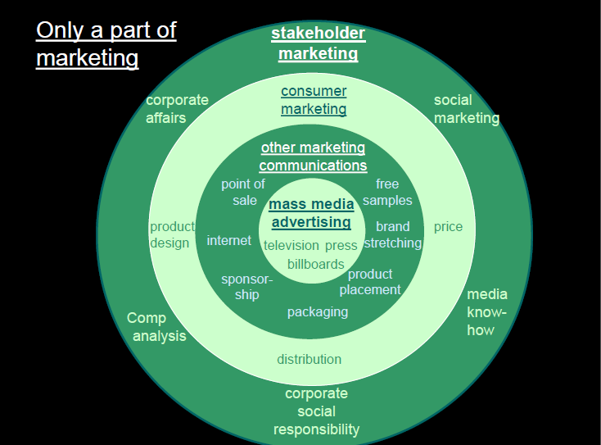
What is marketing promotion?
“Marketing promotion” refers to any form of commercial communication or message that is designed to, or has the effect of, increasing the recognition, appeal and/or consumption of particular products and services. It comprises anything that acts to advertise or otherwise promote a product or service
Notes:
Main point: not just agriculture

Slide 10
Broadcast
TV and radio
Cinema
Pre-film spot adverts
Print Media
Newspapers, magazines, comic
books
Avenues used to promote products
Outdoors
Billboards, posters, moving vehicles
Packaging
Brand or licensed character, giveaways
Online
Social networking sites, blogs and vlogs, media clips, search engines
Notes:
There are many and increasing avenues used to market foods to children. More traditional mediums include broadcast media (comprised of television and radio) and print media. Children can also be exposed to food advertising outdoors on billboards for example, and before films at the cinema. More recent and frequently evolving marketing avenues now occur online, where food brands now represent themselves on social media and via advergames to engage children and teenagers.

Slide 11
Particular challenge of “user generated” content
Notes:
Also HACCP waste
Industry ays – we are meeting consmer demand
Incredibly successful

Slide 12
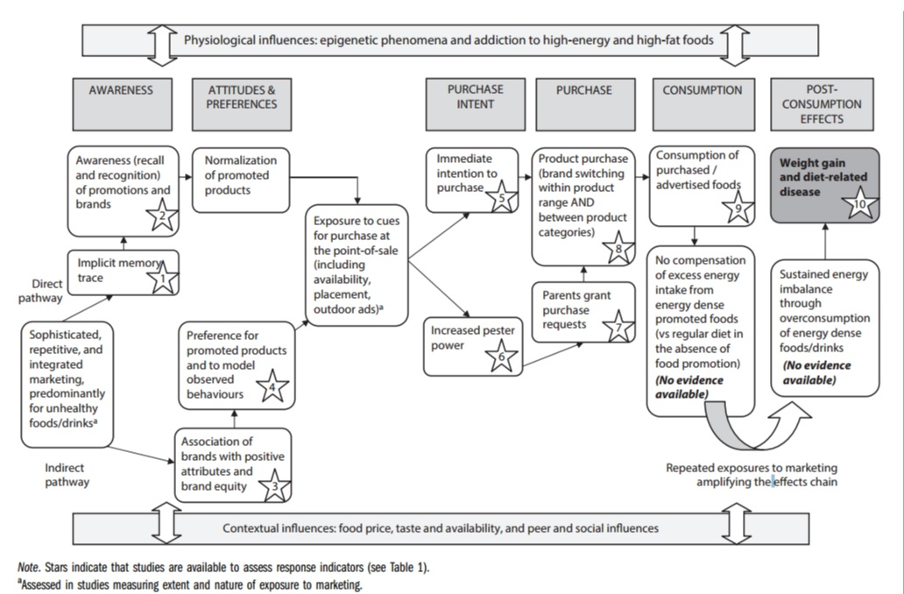
Why act? Effects of marketing promotions…
Notes:
Main point: not just agriculture

Slide 13
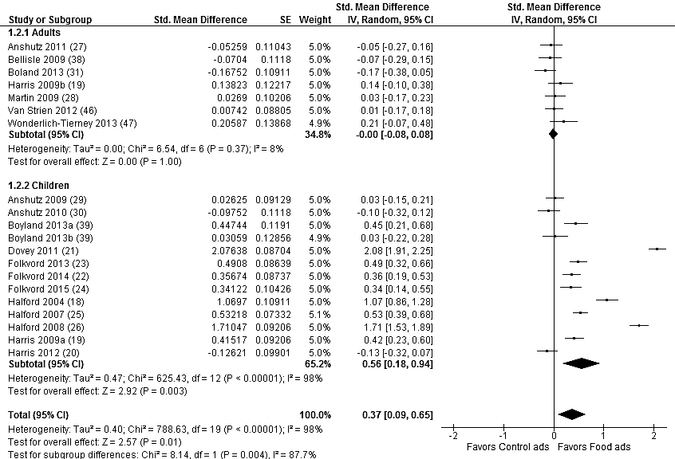
Why act?
Evidence indicates that the effectiveness of marketing communications depends on the reach, frequency and impact of the message (thus influencing exposure) and the content, design and execution of the marketing message (which influences the power of the communication).
Impact of food advertising on consumption

Slide 14
Vision: what do we want to see in terms of changes to the way products are marketed?
use fiscal policies and marketing controls to full effect to influence demand, access and affordability for tobacco, alcohol and HFSS foods and drinks
undertake a comprehensive ban on all tobacco advertising, promotion and sponsorship
prevent inappropriate and irresponsible advertising and marketing for alcohol that targets children and young people
adopt strong measures that reduce the overall impact on children and adults of all forms of marketing (including online) of HFSS foods and drinks
Notes:
Main point: simple vision, but equity crucial

Slide 15
Promoting healthy food environments
Priority policy options | Objective
Strong controls on marketing, incl. but not limited to TV advertising | Reduce exposure of children to marketing of HFSS foods
Fiscal measures and price policies | Explore policies that affect the price of foods for consumers at point of purchase & create incentives to improve nutritional quality of food supply
Consumer-friendly front of pack labelling | Identify foods for which consumption should be limited or promoted through interpretative labelling; encourage product reformulation
Reformulation, calorie reduction, smaller portions | Stimulate reformulation of food products to improve nutritional composition; regulate the use of specific harmful ingredients (e.g. iTFAs); incentivize smaller portion sizes to prevent over-consumption
Healthier food retail environment, incl. in schools | Improve availability & affordability of healthier food products, through strategic purchasing/procurement, in-store product location and promotion. Introduce school food policies, including food-based standards & restrictions on vending machines.
Notes:
15

Slide 16
Policies on marketing of food and non-alcoholic beverages to children
25 countries reported having measures being implemented
29%
define which foods and beverages are covered
29%
define age of the children to which the measure apply
9%
Clearly define the marketing techniques covered
Only 7 countries use a Nutrient profile
Notes:
Our of 38 countries in the WHO Euro Region, 22 countries reported measures to regulate or guide marketing of food and non-alcoholic beverages to children being implemented.
Among this 22 countries, 55% (12 countries)
reported that their measures clearly define which food and beverages are covered, which is are mainly defined by nutrient profiling
&
reported that their measures clearly define the age to which the measure apply, which is for the majority of countries to children to under 12

Slide 17
Scope of policies on marketing of food and non-alcoholic beverages to children
Limited to no action on some important factors known to influence children’s preferences and behaviours
Notes:
Our of 38 countries in the WHO Euro Region, 22 countries reported measures to regulate or guide marketing of food and non-alcoholic beverages to children being implemented.
Among this 22 countries, 55% (12 countries)
reported that their measures clearly define which food and beverages are covered, which is are mainly defined by nutrient profiling
&
reported that their measures clearly define the age to which the measure apply, which is for the majority of countries to children to under 12

Slide 18
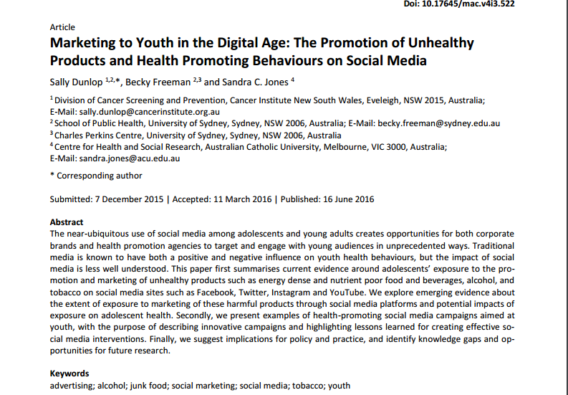
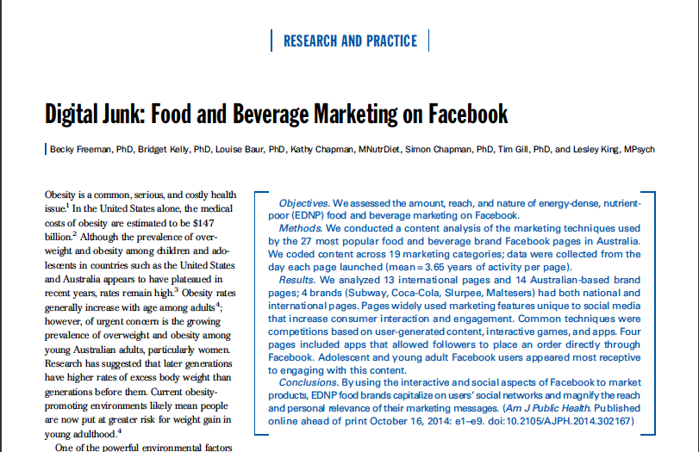
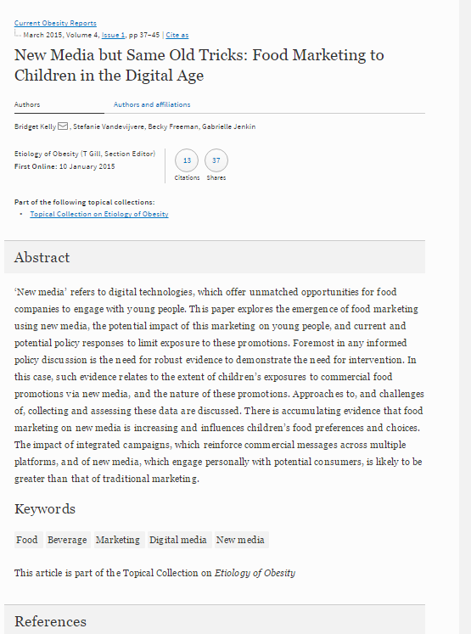
Are existing measures “fit for purpose”?
Notes:
Our of 38 countries in the WHO Euro Region, 22 countries reported measures to regulate or guide marketing of food and non-alcoholic beverages to children being implemented.
Among this 22 countries, 55% (12 countries)
reported that their measures clearly define which food and beverages are covered, which is are mainly defined by nutrient profiling
&
reported that their measures clearly define the age to which the measure apply, which is for the majority of countries to children to under 12

Slide 19
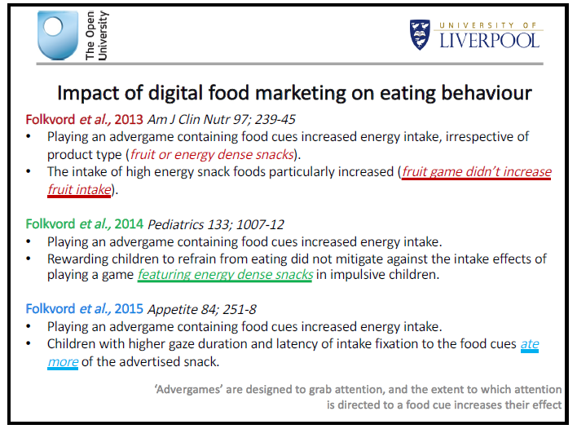

Slide 20
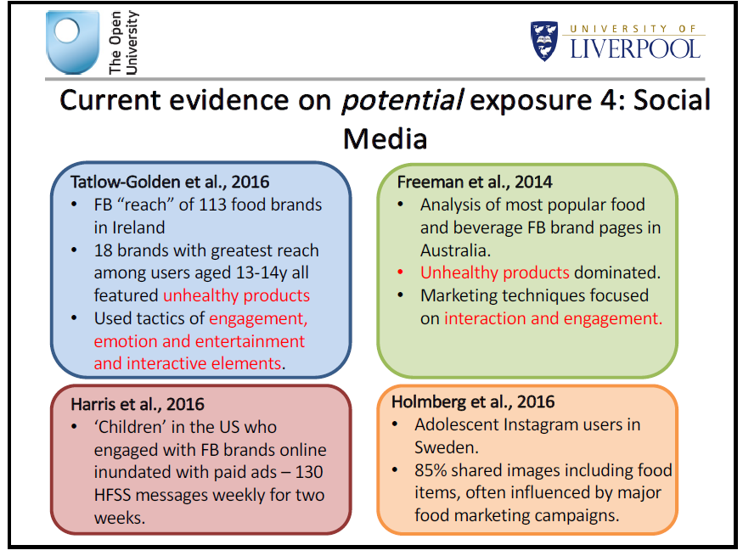

Slide 21
What the evidence tells us
Children and adolescents are exposed to marketing of HFSS products, both through traditional and “new” digital media
Marketing influences behaviours
Children and adolescents not only willingly engage with brands, they also create free word-of-mouth (often stimulated by companies)
Increasing the visibility of users on social media among their peers—or fellow consumers—is a distinctive social media marketing tactic
Very high popularity of the sugar-sweetened soda and energy drink pages

Slide 22
Should we be doing something about it?
YES!
WHO recommendations call for a comprehensive policy approach;
Offline protections (e.g. TV restrictions) should logically be extended to online areas;
The age range to which protection applies should be defined by governments, not commercial entities;
Clear definitions of the types of marketing covered and how this is applied in practice (i.e. what is considered marketing to children), should also be agreed by governments;
Compel private Internet platforms to remove non-compliant marketing;
Action on internet marketing – by its nature cross-border – lends itself particularly well to action across countries (e.g. via Eurasian Economic Union?)

Slide 23
WHO technical support to countries
2010
2016
2012
2011
2015

Slide 24
WHO nutrient profile model – helping to establish stricter criteria for marketing restriction
Notes:
24

Slide 25
Notable progress in region - marketing
Slovenia adopts the WHO/Europe nutrient profile model in national legislation
UK introduces new rules on digital marketing to harmonise with legislation on traditional media
Portugal adopts national legislation on marketing to children, including digital media
Norway develops a government monitoring framework to rigorously evaluate self-regulatory scheme
Russia and Turkey perform studies monitoring HFSS marketing on TV and Internet

Slide 26
Thank you
Acknowledgement to Dr Mimi Tatlow-Golden, Dr Emma Boyland and Dr Becky Freeman for some slides and intellectual input
Notes:
I am here to talk about new rpeort that IPES Food is publishing today on food polcies designed to tackle the challenges posed by the food system, including NCDs
Policies that can help address NCDs at an urban level; its not only about NCDs; in fact its not even mainly focused on NCDs, but I think that’s actually something we can learn from and I will come back to that later

